Slide 1
Physical Reservoir Computing for Classification of Temporal Data
Charlie Bushman

Slide 2
Outline
What is reservoir computing?
A little machine learning
Characteristics of a good reservoir
A mechanical reservoir
A quantum reservoir
What can we do with RC?
Notes:
Necessary grounding in ML

Slide 3
What is Reservoir Computing?

Slide 4
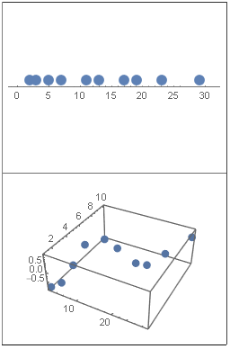
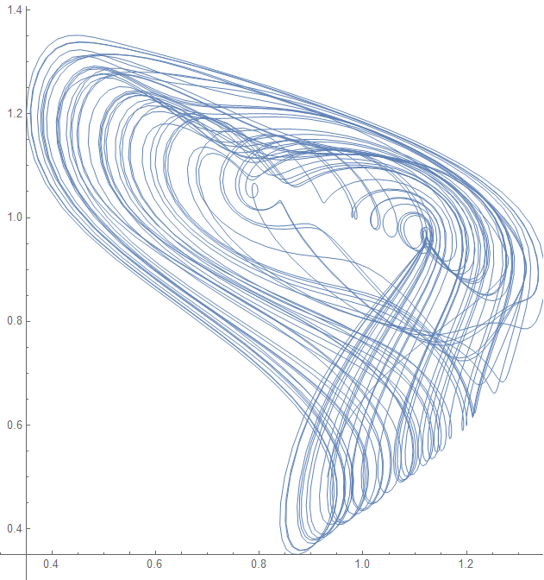
Reservoir computing is a framework for computation derived from recurrent neural network theory that maps input signals into higher dimensional computational spaces through the dynamics of a fixed, nonlinear system called a reservoir
“maps input signals into higher dimensional computational spaces”
“a framework for computation”
“recurrent neural network theory”
“dynamics of a fixed, nonlinear system”
Data
Do stuff
Useful results
What is RC? • A little ML • Chars of a good res • A mechanical res • A quantum res • What can we do with RC?

Slide 5
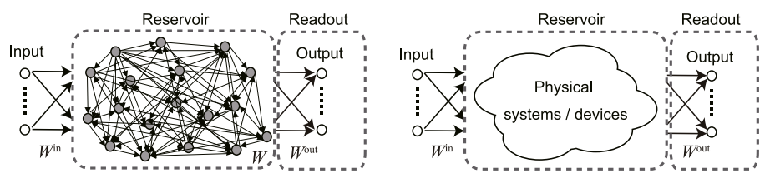

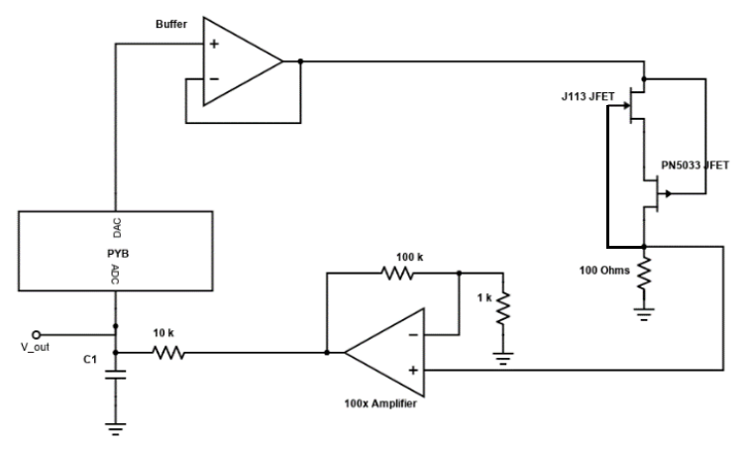
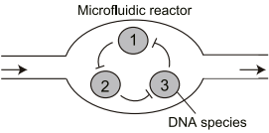
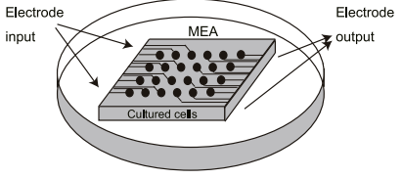
Typical Reservoir Computing
Physical Reservoir Computing
What is RC? • A little ML • Chars of a good res • A mechanical res • A quantum res • What can we do with RC?
Notes:
So that is reservoir computing and here you can see a graphic of the whole framework, and the fact that this framework can achieve state of art computing performance is mind boggling enough
But it gets better

Slide 6
A little machine learning
Notes:
5:00

Slide 7




Apple
How do we learn?
{ , , , , , , }
Training
{ A , O , O , A , A , A , O }
What is RC? • A little ML • Chars of a good res • A mechanical res • A quantum res • What can we do with RC?
Notes:
Training based in repeated exposure to similar experiences
Take baby learning to classify apples and oranges
Neat party trick

Slide 8
{ , , , , , , }
Input
How do machines learn?
{ , , , , , , }
Untrained Algorithm
Training
Trained Algorithm
Output
Expected Output
{O,O,A,O,O,A,A}
{O,A,O,A,O,A,A}
{A,O,O,A,A,A,O}
What is RC? • A little ML • Chars of a good res • A mechanical res • A quantum res • What can we do with RC?
Notes:
This is an example of a binary classification task

Slide 9
What is training for machines?
Input Layer
Hidden Layer(s)
Output Layer
What is RC? • A little ML • Chars of a good res • A mechanical res • A quantum res • What can we do with RC?
Notes:
NN made up of layers of nodes which are unidirectionally connected by edges to each node in the next layer
Input, output, and hidden layers
Just to formalize, introduce notation, don’t freak out

Slide 10
{ }
i_{1,1} i_{2,1} i_{3,1}
i_{1,2} i_{2,2} i_{3,2}
i_{1,3} i_{2,3} i_{3,3}
What is training for machines?
{ }
I =
o_{1,1} o_{2,1} o_{3,1}
o_{1,2} o_{2,2} o_{3,2}
O =
i_{1,1}
o_{1,1}
u₁
x₁
i_{1,2}
i_{1,3}
o_{1,2}
y₁
Class 1
i_{2,1}
o_{2,1}
i_{2,2}
u₂
x₂
i_{2,3}
o_{2,2}
y₂
Class 2
i_{3,1}
o_{3,1}
i_{3,2}
u₃
x₃
o_{3,2}
i_{3,3}
Input Layer
Hidden Layer(s)
Output Layer
u_{t1} → u_{t2}
x_{t1} → I*u_{t1}
y_{t1} → O*x_{t1}
What is RC? • A little ML • Chars of a good res • A mechanical res • A quantum res • What can we do with RC?

Slide 11
{ }
i_{1,1} i_{2,1} i_{3,1}
i_{1,2} i_{2,2} i_{3,2}
i_{1,3} i_{2,3} i_{3,3}
What is training for machines?
{ }
I =
o_{1,1} o_{2,1} o_{3,1}
o_{1,2} o_{2,2} o_{3,2}
O =
i_{1,1}
o_{1,1}
0.2
0.3
i_{1,2}
i_{1,3}
o_{1,2}
0.9
Class
0.2 0.7 0.1
i_{2,1}
o_{2,1}
i_{2,2}
=
0.7
1.0
i_{2,3}
o_{2,2}
0.1
Class
i_{3,1}
o_{3,1}
i_{3,2}
0.1
0.5
o_{3,2}
i_{3,3}
Input Layer
Hidden Layer(s)
Output Layer
u_{t1} → u_{t2}
x_{t1} → I*u_{t1}
y_{t1} → O*x_{t1}
What is RC? • A little ML • Chars of a good res • A mechanical res • A quantum res • What can we do with RC?

Slide 12
{ }
i_{1,1} i_{2,1} i_{3,1}
i_{1,2} i_{2,2} i_{3,2}
i_{1,3} i_{2,3} i_{3,3}
What is training for a reservoir?
{ }
I =
o_{1,1} o_{2,1} o_{3,1}
o_{1,2} o_{2,2} o_{3,2}
O =
w_{1,1}
i_{1,1}
o_{1,1}
u₁
x₁
i_{1,2}
i_{1,3}
o_{1,2}
w_{1,3}
y₁
i_{2,1}
{ }
o_{2,1}
w_{1,1} 0 0
0 0 w_{3,2}
w_{1,3} w_{2,3} 0
i_{2,2}
u₂
x₂
W =
i_{2,3}
o_{2,2}
w_{2,3}
w_{3,2}
y₂
i_{3,1}
o_{3,1}
i_{3,2}
u₃
x₃
o_{3,2}
i_{3,3}
Input Layer
Reservoir
Output Layer
u_{t1} → u_{t2}
x_{t1} → f (I*u_{t1}, W*x_{t1})
y_{t1} → O*x_{t1}
What is RC? • A little ML • Chars of a good res • A mechanical res • A quantum res • What can we do with RC?
Notes:
The hidden layers have been replaced with a recurrent reservoir
This makes it a RNN
Whereas with a FFNN we needed to train input, output, and any hidden layer weights, here we only need to train output weights

Slide 13
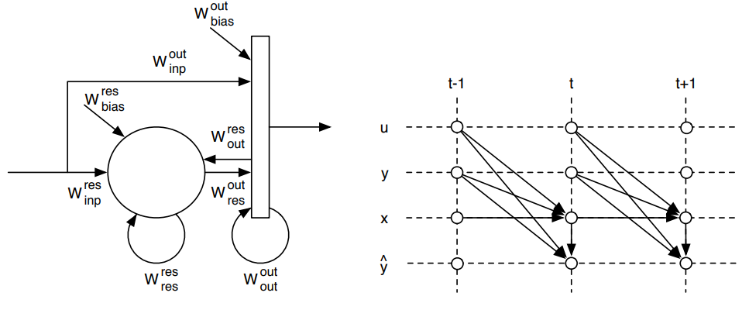
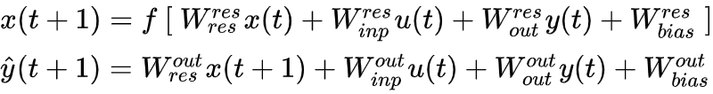
The reservoir computing framework
y(t)
Legend
x(t) → Reservoir state
u(t) → Input vector
y(t) → Output vector
ŷ(t) → Computed output vector
ŷ(t)
u(t)
x(t)
Nonlinear function
Constant bias weights
What is RC? • A little ML • Chars of a good res • A mechanical res • A quantum res • What can we do with RC?
Notes:
Same thing but with a few more connections added in
Second graph shows evolution of each vector with each time step
y and y hat, just ignore, only matters if you’re going to build one of these things

Slide 14
Characteristics of a good reservoir
Notes:
15:00

Slide 15
Characteristics of a good reservoir
Nonlinearity
High Dimensionality
Echo State Property
Separability, Generalizability, Kernel Quality and more

Slide 16
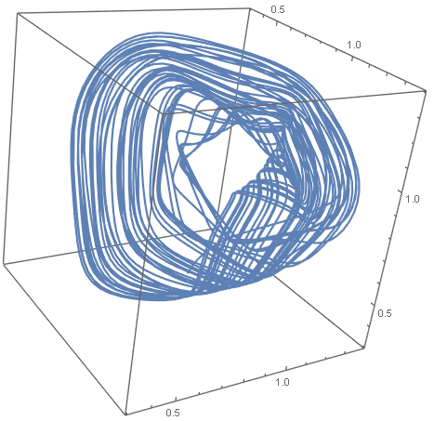
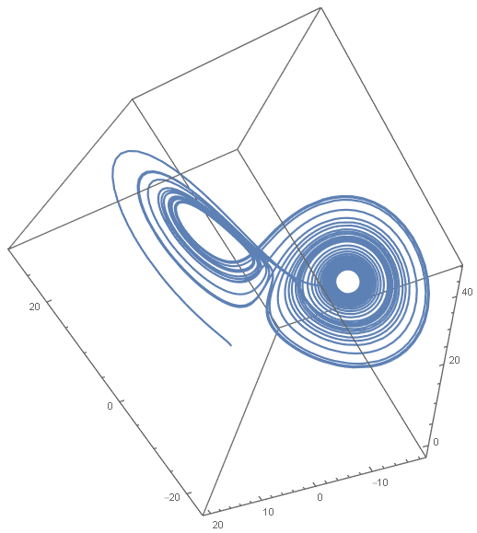
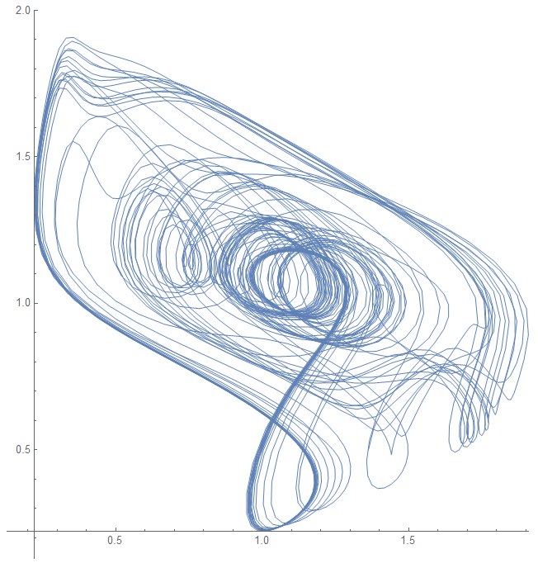
Nonlinearity
f (a + b) ≠ f (a) + f (b)
“Using a term like nonlinear science is like referring to the bulk of zoology as the study of non-elephant animals.”
- Stanislaw Ulam
What is RC? • A little ML • Chars of a good res • A mechanical res • A quantum res • What can we do with RC?
Notes:
Nonlinearity, definition, quote
Really what we mean by nonlinearity is complexity and what we mean by complexity is chaos
You can see some chaotic systems around the edges here visualized as attractors
Attractor: Something a system’s trajectory orbits around in phase space
Phase space: space in which every possible state of the system is represented by one point
Lorentz with x,y,z parameters
Time delay embedding: facsimile of phase space with only one dimension of system dynamics

Slide 17
High Dimensionality
What is RC? • A little ML • Chars of a good res • A mechanical res • A quantum res • What can we do with RC?
Notes:
So dimensionality of a system can be viewed as the number of parameters that fully describe the system
But a lower signal dimension is where complex dynamics of signals in the reservoir live
How to measure signal dimension
Information dimension, but we’re not gonna worry about how to calculate, lots of information theoretic stuff

Slide 18
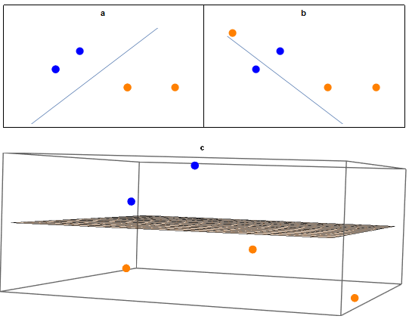
High Dimensionality
What is RC? • A little ML • Chars of a good res • A mechanical res • A quantum res • What can we do with RC?
Notes:
How it helps with classification tasks
Linear separator from linear output layer
This is why we need a high signal dimension

Slide 19
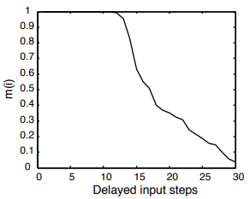
Echo State Property
(a.k.a. Fading Memory Property)
Typical FFN Tasks
(Independent inputs)
Image recognition
Web scraping
Data preprocessing
Typical LSTM Tasks
(Context dependent inputs)
Speech recognition
Handwriting recognition
Anomaly detection in network traffic
What is RC? • A little ML • Chars of a good res • A mechanical res • A quantum res • What can we do with RC?
Notes:
Memory but not dependent on not precisely controllable initial conditions of chaotic system
Feedforward network tasks vs long short term memory tasks (variant of RNN architecture)
Hit on the “classification of temporal data” part of the title here
Difference between training and memory

Slide 20
A mechanical reservoir
Notes:
25:00

Slide 21
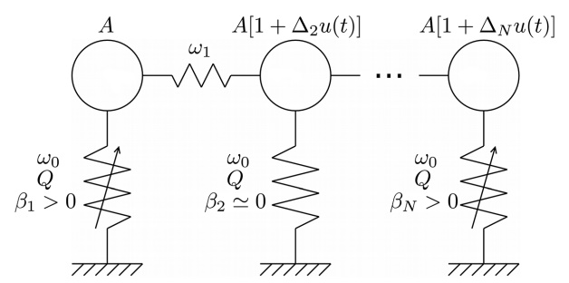
Coulombe et al.’s Mechanical Reservoir
What is RC? • A little ML • Chars of a good res • A mechanical res • A quantum res • What can we do with RC?
Notes:
Not Coulomb’s Law guy
Explain system
How is it used as a reservoir
Inputs as driving force
Outputs as vertical positions

Slide 22


Harmonic oscillator
What is RC? • A little ML • Chars of a good res • A mechanical res • A quantum res • What can we do with RC?

Slide 23
Anharmonic oscillator
What is RC? • A little ML • Chars of a good res • A mechanical res • A quantum res • What can we do with RC?

Slide 24
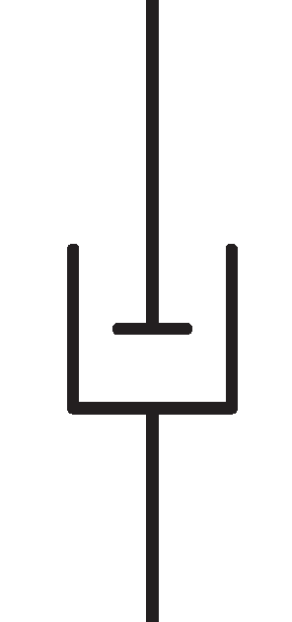
Damped anharmonic oscillator
What is RC? • A little ML • Chars of a good res • A mechanical res • A quantum res • What can we do with RC?
Notes:
Over, under and critical damping

Slide 25
Damped anharmonic oscillator
What is RC? • A little ML • Chars of a good res • A mechanical res • A quantum res • What can we do with RC?
Notes:
Over, under and critical damping

Slide 26
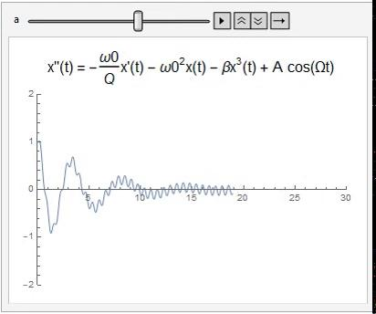
Duffing oscillator
What is RC? • A little ML • Chars of a good res • A mechanical res • A quantum res • What can we do with RC?
Notes:
Driving close to w0 resonant frequency gets continued large amplitude motion

Slide 27
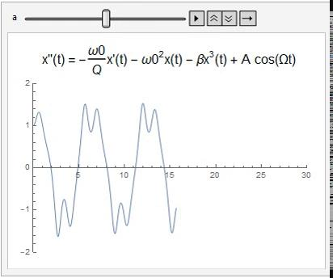
Duffing oscillator
What is RC? • A little ML • Chars of a good res • A mechanical res • A quantum res • What can we do with RC?
Notes:
Driving close to w0 resonant frequency gets continued large amplitude motion

Slide 28
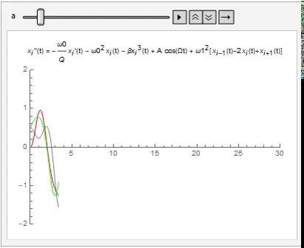
Coupled Duffing oscillators
What is RC? • A little ML • Chars of a good res • A mechanical res • A quantum res • What can we do with RC?

Slide 29
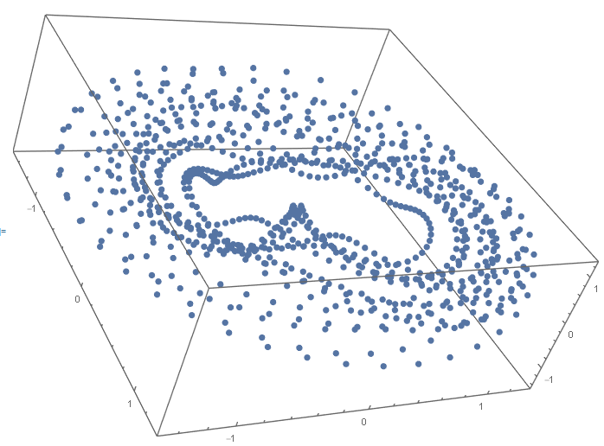
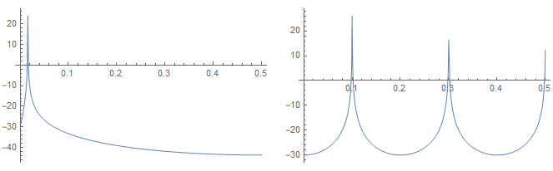
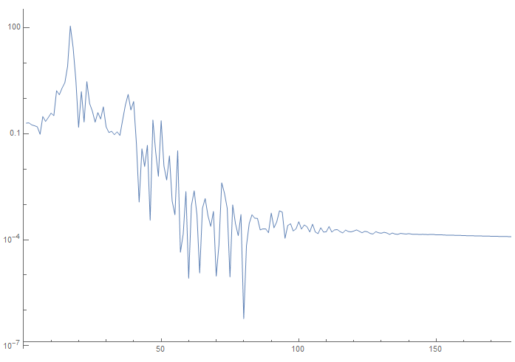
Nonlinearity
Sine wave
Square wave
Coupled mechanical oscillators
What is RC? • A little ML • Chars of a good res • A mechanical res • A quantum res • What can we do with RC?
Notes:
Showing that something is a chaotic attractor is hard
Embedding plot exhibits orbiting dynamics
Fourier is smoothish curve
Bifurcation diagram shows chaotic region

Slide 30
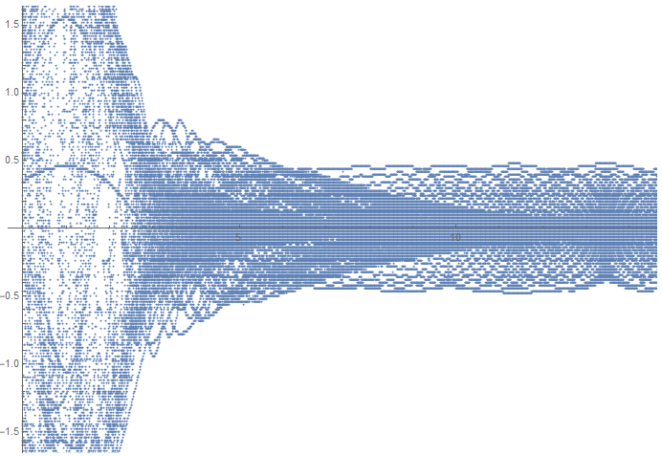
Nonlinearity
What is RC? • A little ML • Chars of a good res • A mechanical res • A quantum res • What can we do with RC?
Notes:
What the x and y axes are
Falls off as resonant and driving frequencies diverge

Slide 31
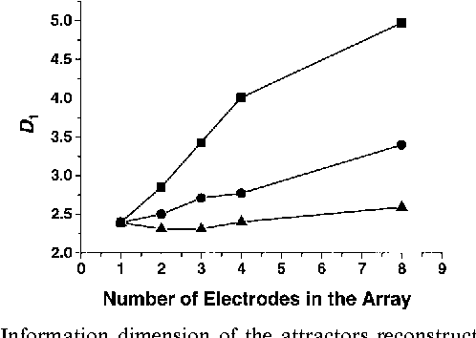
High dimensionality and fading memory
What is RC? • A little ML • Chars of a good res • A mechanical res • A quantum res • What can we do with RC?
Notes:
Information dimension of chemical system with same dynamics
Squares, circles, triangles just vary a system parameter
Memory from coupling, fading from damping

Slide 32
A quantum reservoir
Notes:
35:00

Slide 33
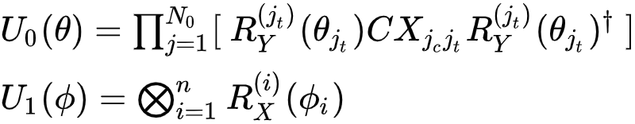
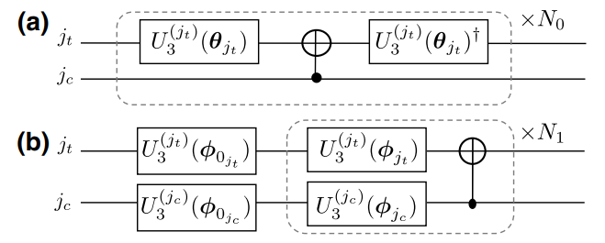
Chen et al.’s Quantum Reservoir
U₀
U₁
What is RC? • A little ML • Chars of a good res • A mechanical res • A quantum res • What can we do with RC?
Notes:
How this is used as a reservoir
Inputs mapped in as parameters to T quantum logic gate
Outputs as measured values
Roadmap the section
Transmon
Qubits and gate based quantum computing
Reservoir

Slide 34
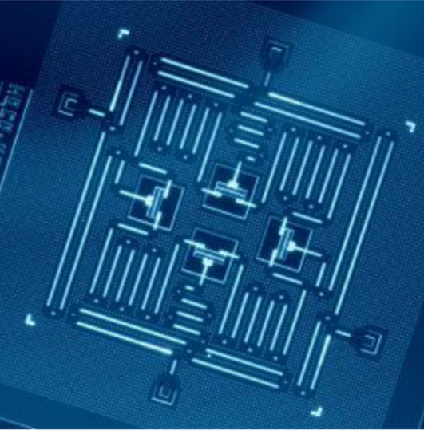
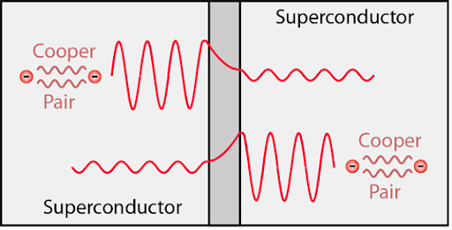
The Transmon
What is RC? • A little ML • Chars of a good res • A mechanical res • A quantum res • What can we do with RC?
Notes:
Physical implementation of a qubit
Fundamental unit in this quantum computer’s architecture
Like transistor bits in classical computers
Superconducting circuit with a Josephson junction (nonlinear inductor)
Two superconductors separated by a thin insulator
Cooper pairs, happens in superconducting physics and tunneling from quantum

Slide 35

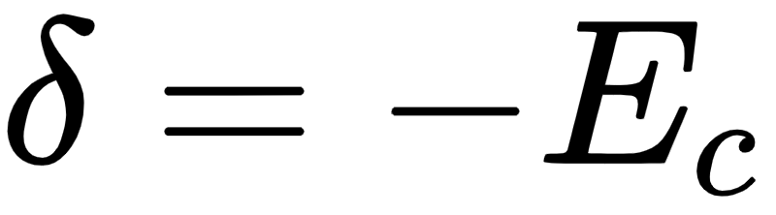
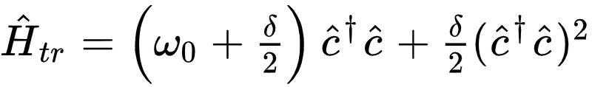
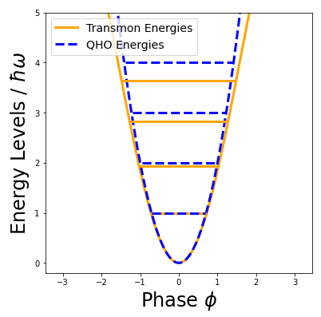
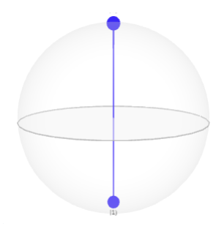

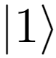
Transmon Dynamics
Transmon’s Hamiltonian in terms of charge (Q) and flux (𝚽)
What is RC? • A little ML • Chars of a good res • A mechanical res • A quantum res • What can we do with RC?
Notes:
Quantized Hamiltonian for the transmon tells us why this is a good choice for a qubit
Energy gaps are nonconstant, unlike QHO
This is the quantum Duffing oscillator!
Most of our arguments about mech will carry over if we can linearly couple qubits
So now the question we need to answer is, how do we linearly couple transmons?

Slide 36
How do we linearly couple qubits?
U₀
U₁
What is RC? • A little ML • Chars of a good res • A mechanical res • A quantum res • What can we do with RC?
Notes:
And the answer is this circuit, or something like it
Because we want to couple in a way that produces chaotic behaviour, not anything too boring

Slide 37
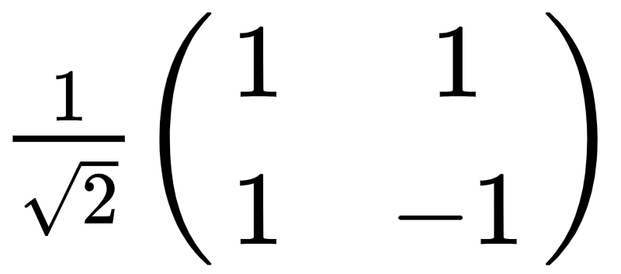
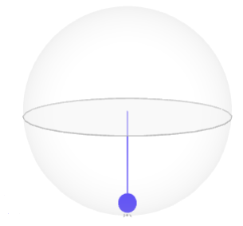
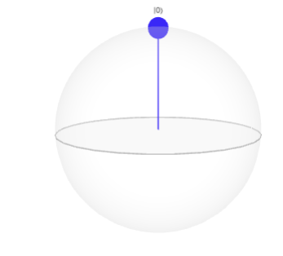
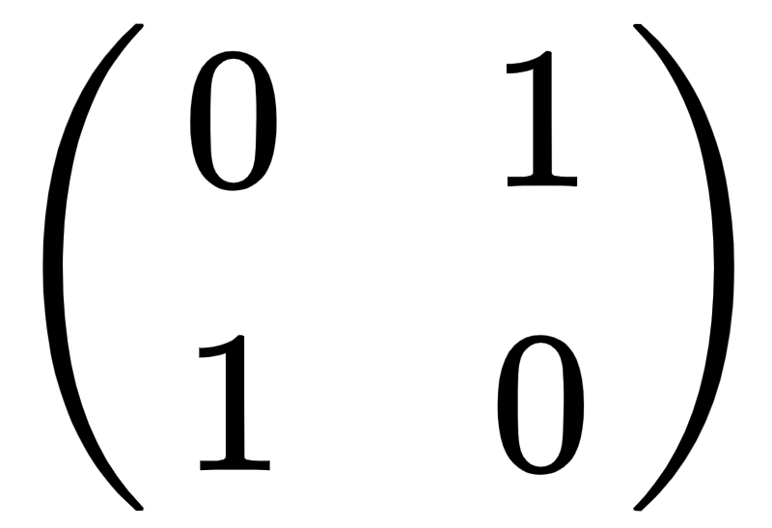
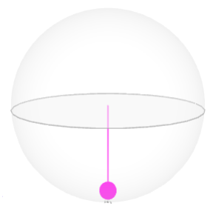
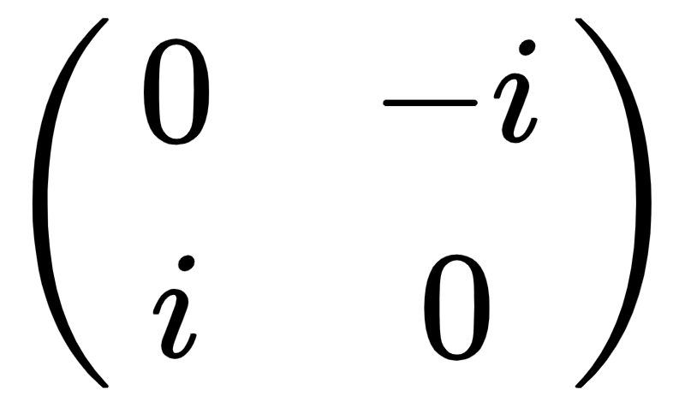
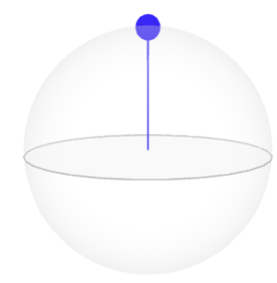
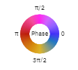
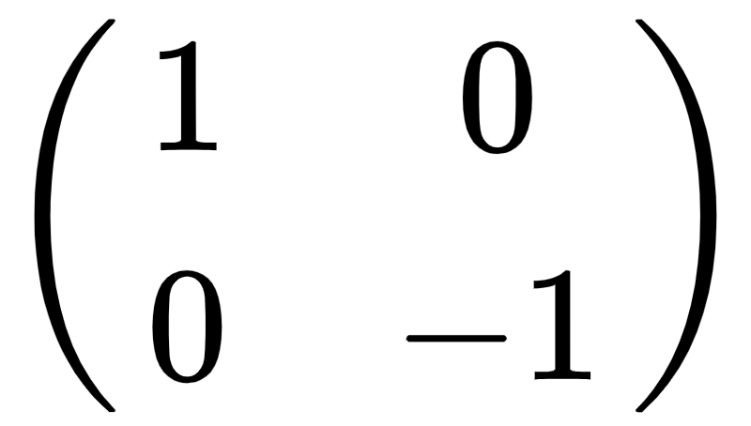
Gate based quantum computing
H
[ 0.707+0j, 0.707+0j ]
[ 1+0j, 0+0j ]
X
[ 0+0j, 1+0j ]
Y
[ 0+0j, 0+1j ]
Z
[ 1+0j, 0+0j ]
What is RC? • A little ML • Chars of a good res • A mechanical res • A quantum res • What can we do with RC?
Notes:
This is a qubit being transformed by any one of these gates to a new state
Given statevector and Bloch sphere representations
0 and 1 in each
Hadamard switches between X and Z computational bases
Logical nots in each computational basis (explain logical not)
0 to a 1 or 1 to a 0
Might recognize as Pauli spin matrices

Slide 38
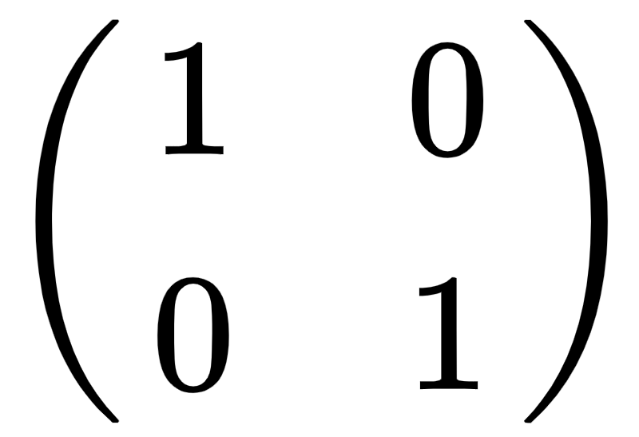
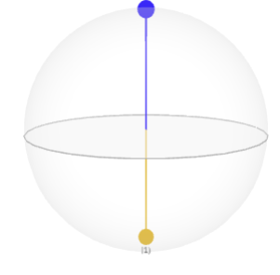
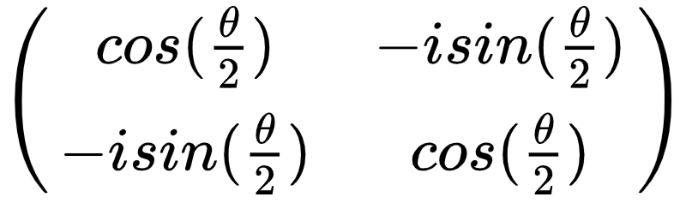
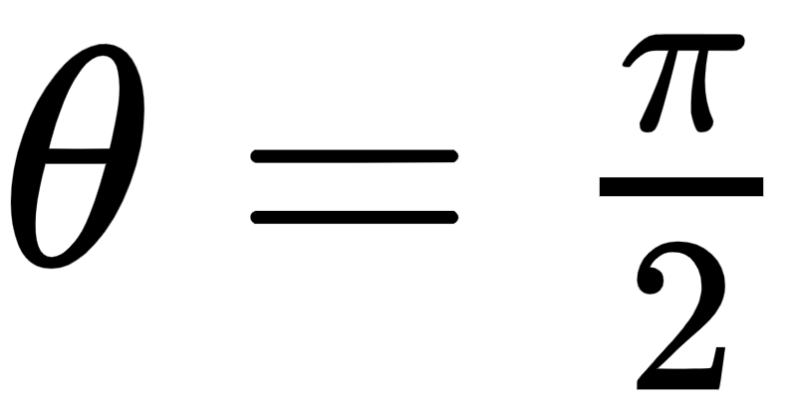
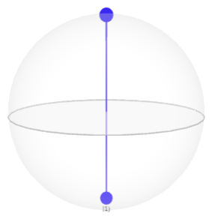
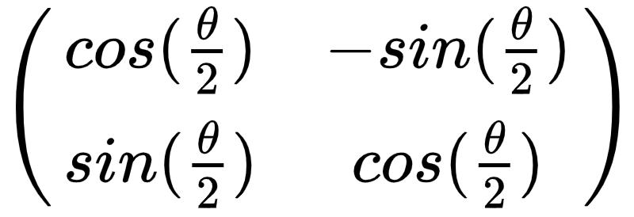
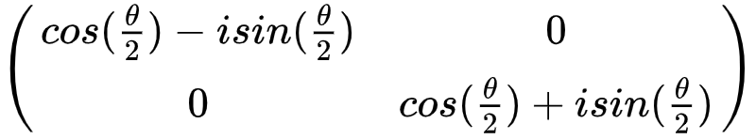
Gate based quantum computing
I
[ 1+0j, 0+0j ]
[ 1+0j, 0+0j ]
R_{X}
[ 0.707+0j, 0-0.707j ]
R_{Y}
[ 0.707+0j, 0.707+0j ]
R_{Z}
[ 1+0j, 0+0j ]
What is RC? • A little ML • Chars of a good res • A mechanical res • A quantum res • What can we do with RC?
Notes:
Identity is boring
Rotations in a basis (around that axis)
Starts in z basis so z rotation does nothing

Slide 39
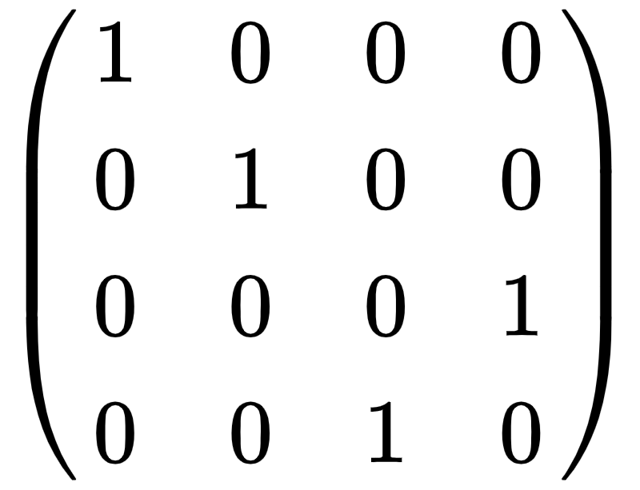
Gate based quantum computing
[ 1+0j, 0+0j, 0+0j, 0+0j ]
[ 1+0j, 0+0j, 0+0j, 0+0j ]
What is RC? • A little ML • Chars of a good res • A mechanical res • A quantum res • What can we do with RC?
Notes:
Statevectors now 00, 01, 10, 11

Slide 40
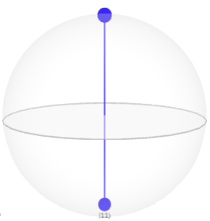
Gate based quantum computing
[ 1+0j, 0+0j, 0+0j, 0+0j ]
[ 0.707+0j, 0+0j, 0+0j, 0.707+0j ]
I
H
What is RC? • A little ML • Chars of a good res • A mechanical res • A quantum res • What can we do with RC?
Notes:
Maximally entangled Bell state
Couples qubits (entangled)
But this is an example of too boring of a coupling, not going to produce chaotic behaviour, it’s 11 or 00

Slide 41
How do we linearly couple qubits?
U₀
U₁
What is RC? • A little ML • Chars of a good res • A mechanical res • A quantum res • What can we do with RC?
Notes:
So now we can return to this circuit for the third and final time and actually understand how it does what we want
U3 is a rotation about all three axes (each angle parameter is actually three angles)
Gate parameters each uniformly and randomly sampled over [-2Pi, Pi]
Dagger denotes the inverse operation (negative angles, same rotations)
U0 does random change of basis (not confined to X,Y,Z) and then back to original with cnot in the middle
U1 performs a rotation on each qubit, no need for that part in simplest formulation
Rho is state of reservoir, u is input, U0 and U1 are those, sigma is bias and epsilon is constant

Slide 42

A quantum reservoir computer
T(u₁)
T(u₂)
T(u₃)
What is RC? • A little ML • Chars of a good res • A mechanical res • A quantum res • What can we do with RC?

Slide 43
What can we do with RC?
Notes:
45:00

Slide 44

Micro Electro-Mechanical Systems
Smart, responsive sensors that can encode ML algorithms in their fabrication
What is RC? • A little ML • Chars of a good res • A mechanical res • A quantum res • What can we do with RC?

Slide 45

Long and Short Term Chaotic Systems Prediction
Reservoirs can precisely predict learned attractor dynamics over the short term and mimic them long term
What is RC? • A little ML • Chars of a good res • A mechanical res • A quantum res • What can we do with RC?
Notes:
Why do we care about predicting chaotic systems
Stock market
Some biorhythms

Slide 46

Understanding the Human Brain
The brain or some regions of the brain could act like reservoirs to process sensory input
What is RC? • A little ML • Chars of a good res • A mechanical res • A quantum res • What can we do with RC?

Slide 47
Review
The reservoir computing framework
Characteristics of a good reservoir
Two examples of physical reservoirs
Potential applications

Slide 48
Thanks!
To my advisors Barry, Helen and Claire for the feedback they have and will continue to provide me
To April Reisenfeld, Axel Stahl, Jack Heinzel, Kyle Fraser-Mines, Rebe Chen, Tim Mikulski for watching and providing critiques of my practice runs
To friends and family for listening to me talk about this all the time
To all the Carleton faculty members who have introduced me to many of the concepts herein
And to you all for being here :)

Slide 49
Questions?

Slide 50
Bibliography
Kiss, I.Z., Wang, W., & Hudson, J.L., "Complexity of globally coupled chaotic electrochemical oscillators", Phys. Chem. Chem. Phys., 2000, 2, 3847-3854.
Schrauwen, B., Verstraeten, D., Campenhout, J.V., "An overview of reservoir computing: theory, applications and implementations", European Symposium on Artificial Neural Networks, 2007.
Tanaka, G., Yamane, T., Heroux, J.B., et al., "Recent advances in physical reservoir computing: A review", 115, 100-123, 2019.

Slide 51












Transmon Dynamics
Transmon’s Hamiltonian in terms of charge (Q) and flux (𝚽)
I₀ - Critical current
Hamiltonian in terms of reduced charge and phase
Taylor expansion in terms of zero point fluctuations, truncated at fourth order
What is RC? • A little ML • Chars of a good res • A mechanical res • A quantum res • What can we do with RC?

